Slide 1
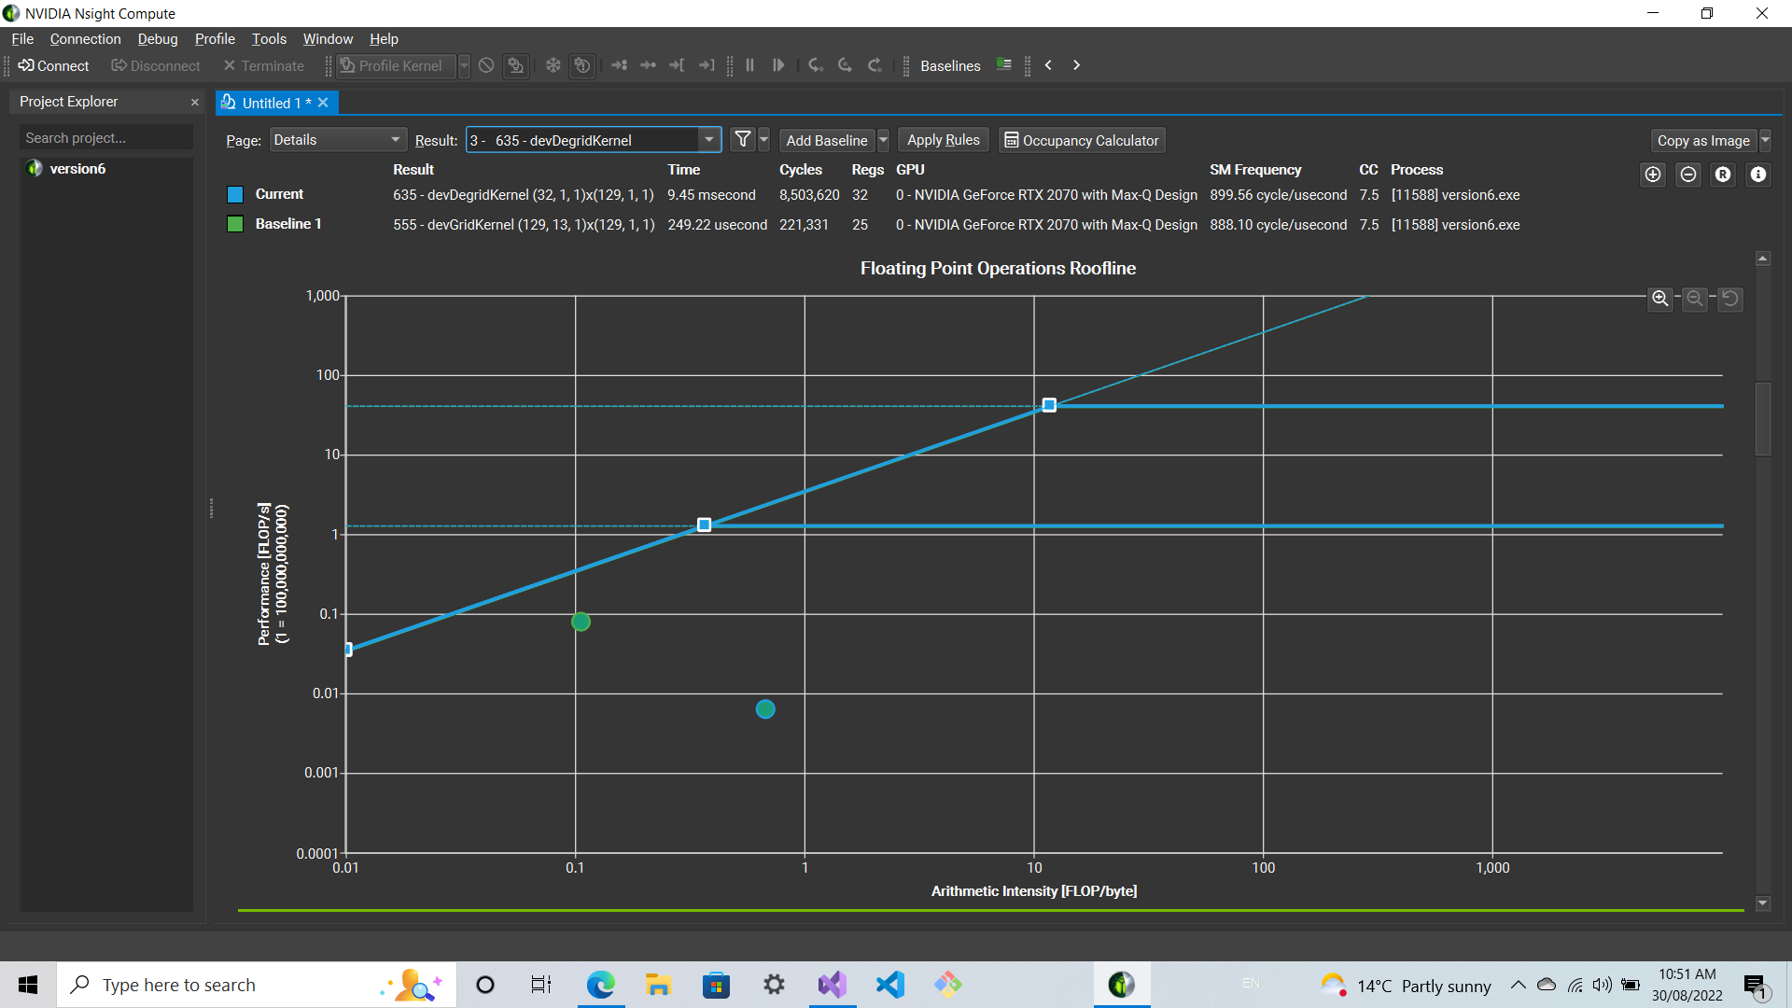
An Introduction to the GPU kernels of YandaSoft
A brief introduction & preliminary performance results
Team ASKAP | 1 September 2022

Slide 2
Sprint Team
Stephen Ord | PI | CSIRO
Daniel Mitchell | Developer | CSIRO
Ozgur Cekmer | Developer | CSIRO
Pero Manojlovic | Developer | CSIRO
Pascal Elahi | Technical POC | Pawsey Centre
Joseph Schoonover | Mentor | Fluid Numerics

Slide 3
Contents
Introduction to GPU kernels of YandaSoft
Convolution
Gridding
Degridding
Deconvolution
CLEAN
Introduction to Roofline Analysis
Methodology
A Sample Case: ASGarD
Preliminary Results of YandaSoft
Convolution
Gridding
Degridding
Deconvolution
CLEAN

Slide 4
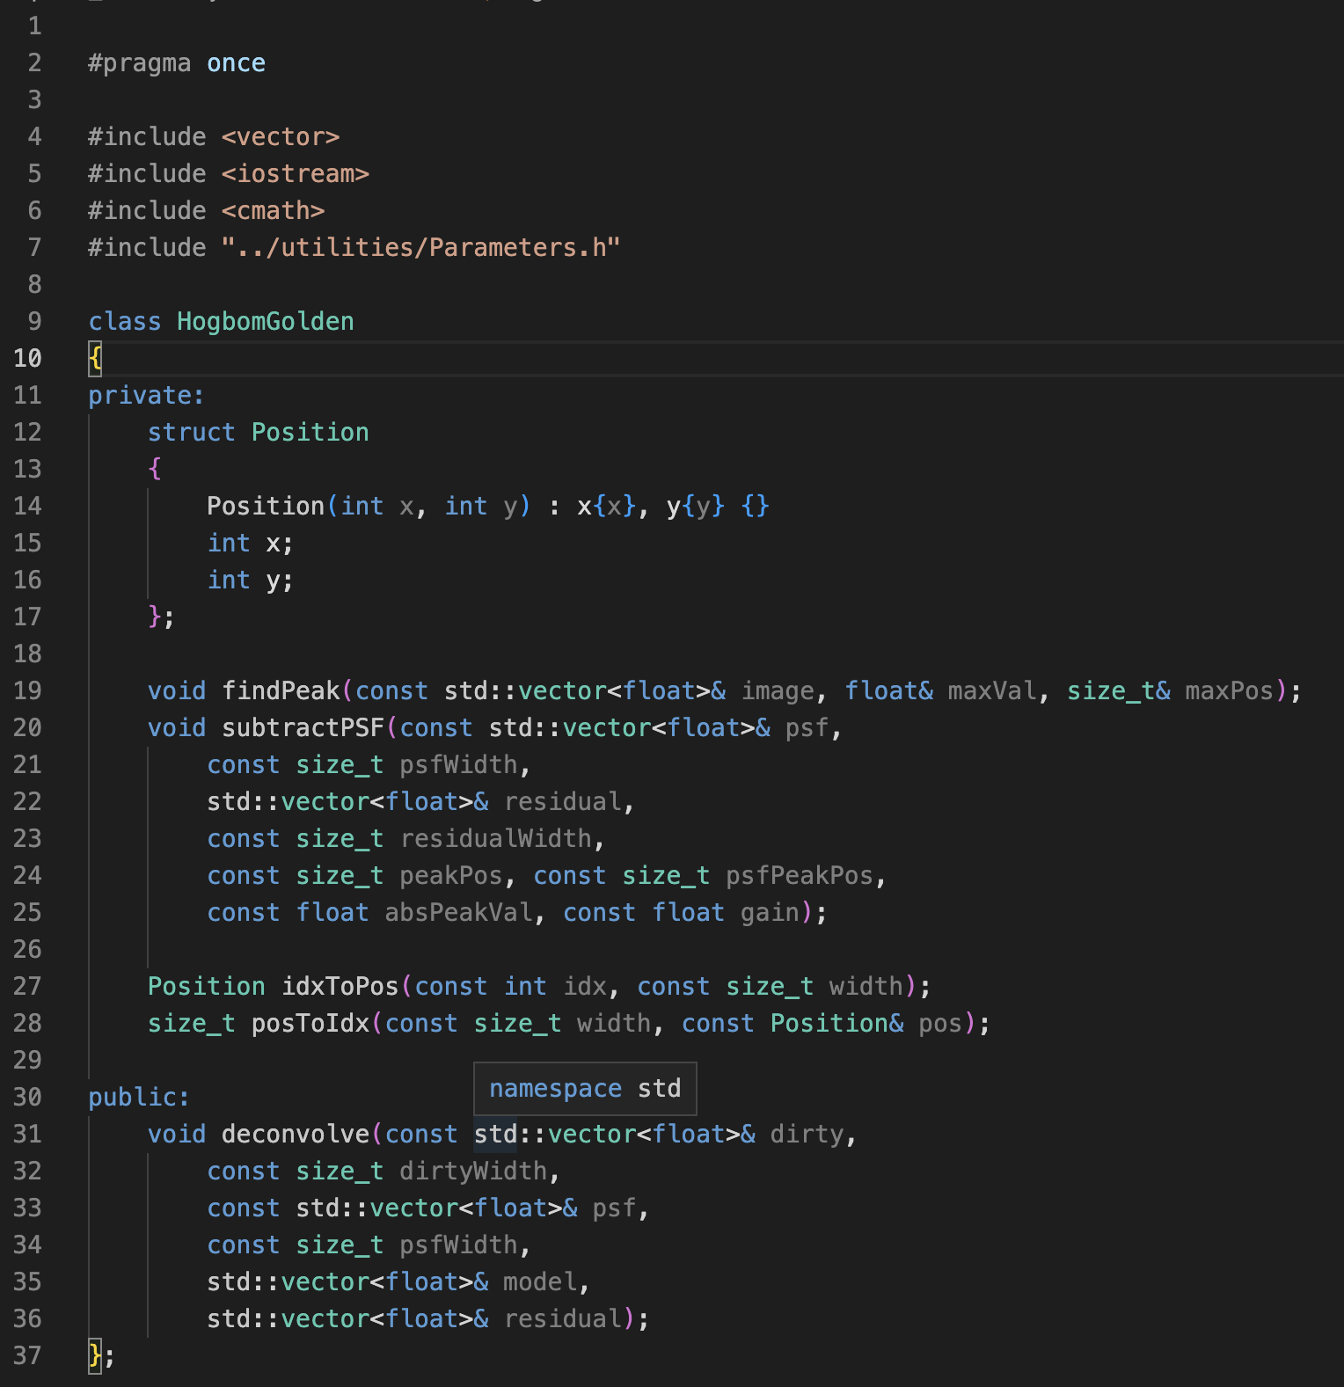
Section 1
An Introduction to the GPU kernels of YandaSoft
Goals for the GPU PACER Meeting

Slide 5
An Introduction to the GPU Kernels of YandaSoft
Convolution
Gridding
Degridding
Deconvolution
Hogbom CLEAN
Operations
Matrix ops
Reductions
Current
C++
CUDA
OpenMP offload
Target
C++
HIP
Performance optimization for the kernels
OpenMP offload?

Slide 6
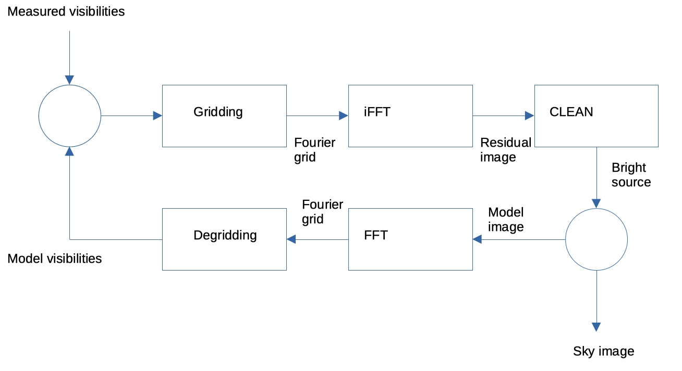
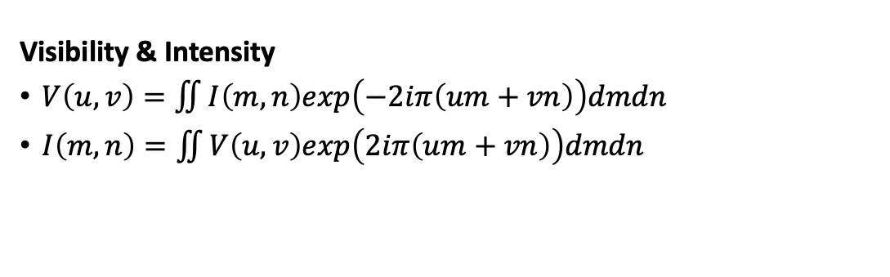
Imaging Pipeline in Summary
Visibility & Intensity
$V\left(u,v\right)=\iint{I\left(m,n\right)exp\left(−2iπ\left(um+vn\right)\right)dmdn}$
$I\left(m,n\right)=\iint{V\left(u,v\right)exp\left(2iπ\left(um+vn\right)\right)dmdn}$
* Adapted from Figure 6.2 of Big Data of Astronomy, Chapter 6 - Processing data of correlation on GPU, Y. Zhu, J. Hou, Y. Song, Y. Zheng, T. Huang, H. Wu, 2020.

Slide 7
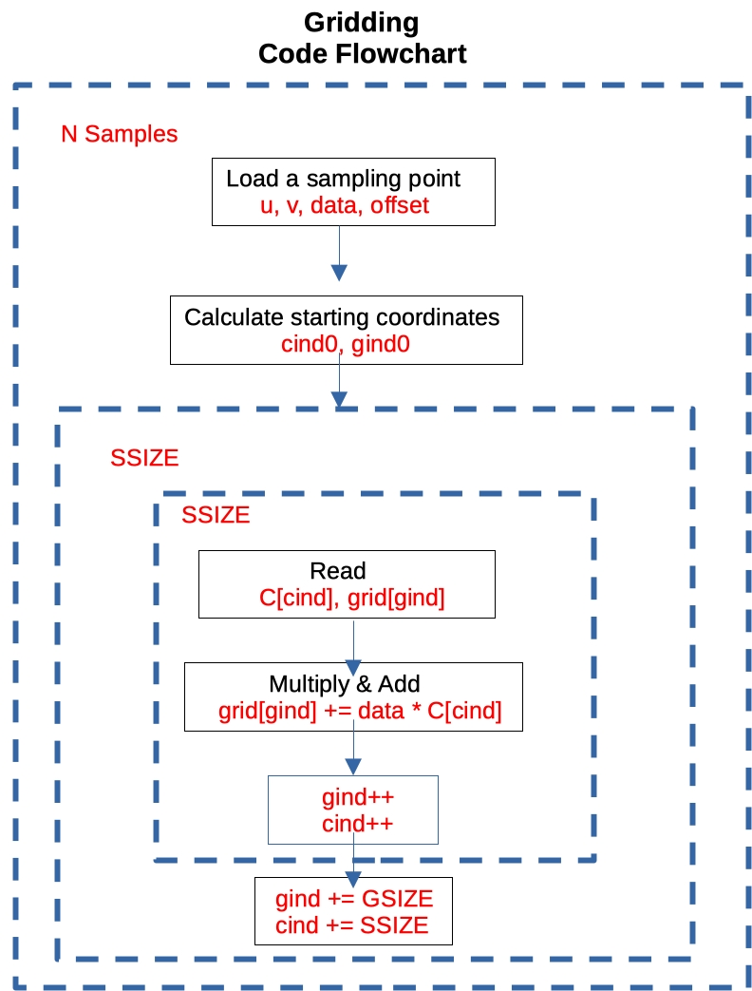
Convolution - Gridding
Gridding
To utilize FFT, the visibility data must be transformed to a regular grid.
This method is called convolutional sampling.
The visibility data are sampled at discrete locations in a 2D space.
These data are then converted into a smooth function by convolving with a finite-size kernel.
* Adapted from Figure 6.3 of Big Data of Astronomy, Chapter 6 - Processing data of correlation on GPU, Y. Zhu, J. Hou, Y. Song, Y. Zheng, T. Huang, H. Wu, 2020.

Slide 8
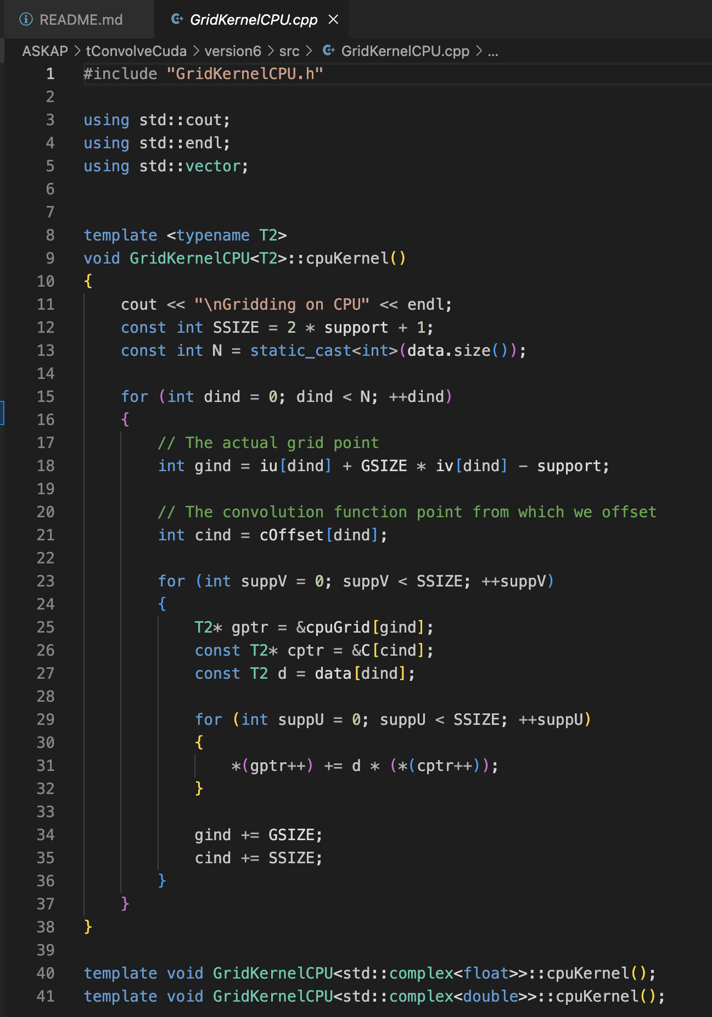
Convolution - Gridding
* Adapted from Figure 6.3 of Big Data of Astronomy, Chapter 6 - Processing data of correlation on GPU, Y. Zhu, J. Hou, Y. Song, Y. Zheng, T. Huang, H. Wu, 2020.

Slide 9
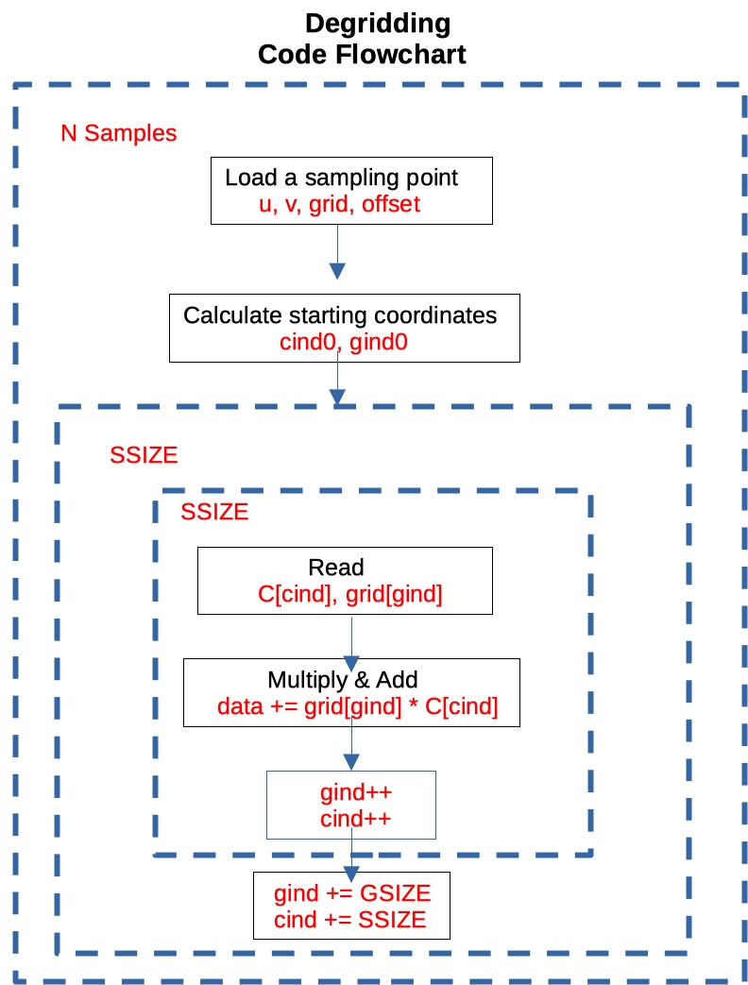
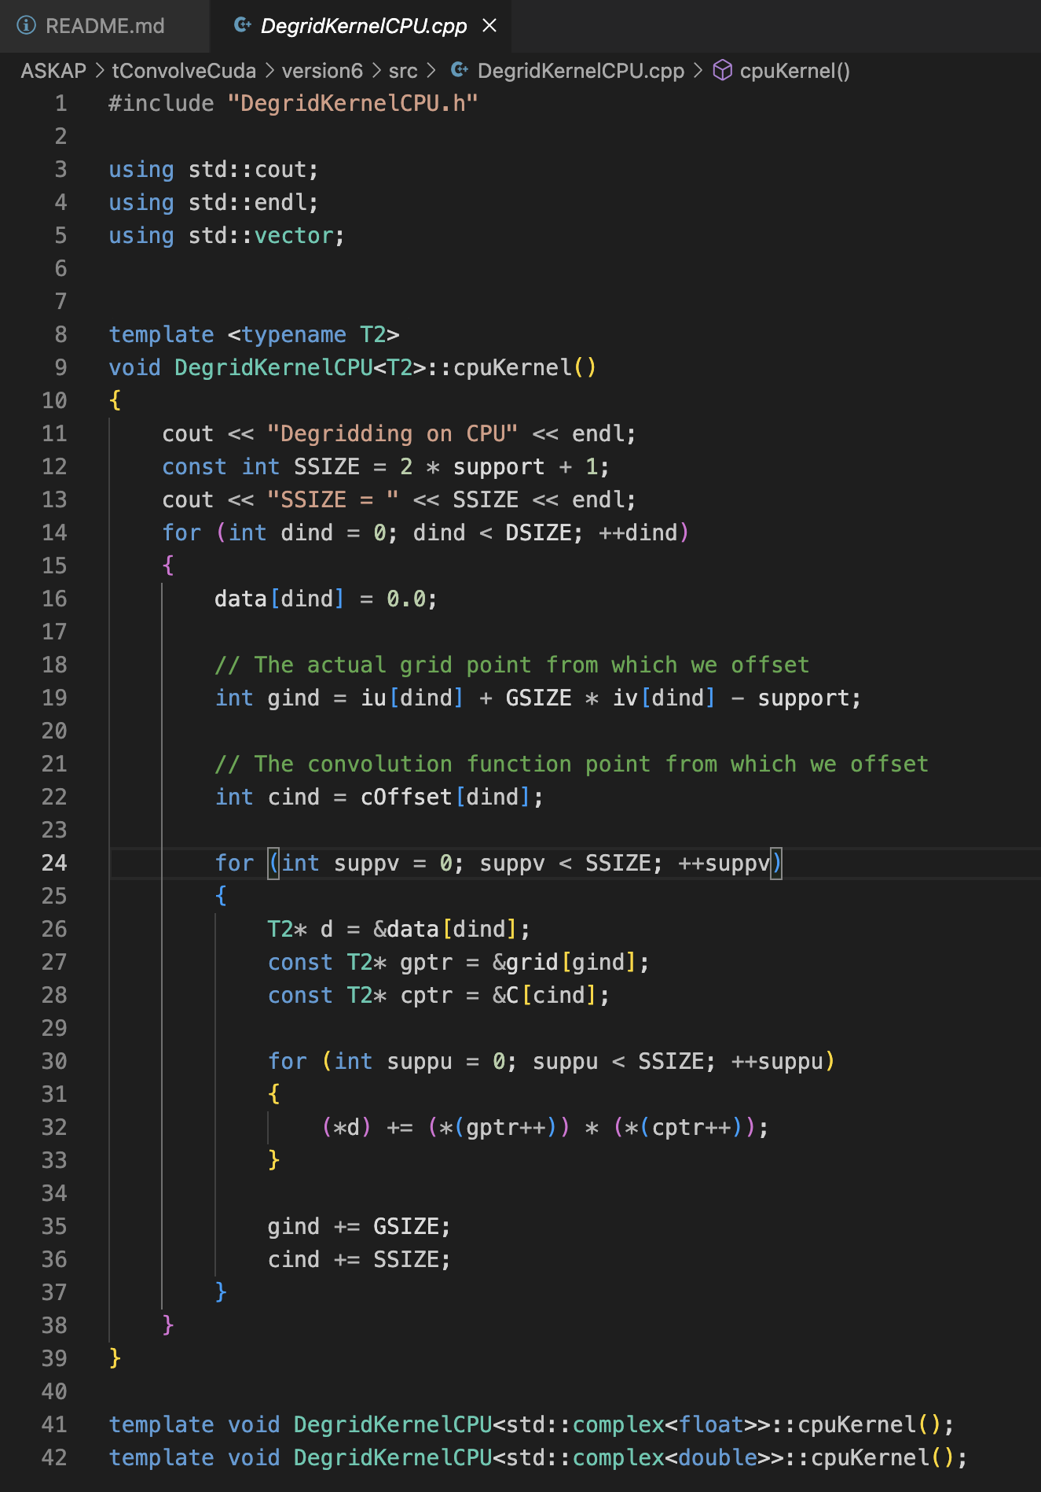
Convolution - Degridding
* Adapted from Figure 6.3 of Big Data of Astronomy, Chapter 6 - Processing data of correlation on GPU, Y. Zhu, J. Hou, Y. Song, Y. Zheng, T. Huang, H. Wu, 2020.

Slide 10
Deconvolution – Hogbom’s CLEAN algorithm
Methodology
Start with the dirty image
Find the brightest pixel
Subtract a fraction (loop gain: around 0.1) of the of the dirty beam from the dirty image at the location of that brightest pixel.
The subtracted image is called the residual image.
Find the new brightest pixel.
Continue the loop until a threshold is reached.

Slide 11
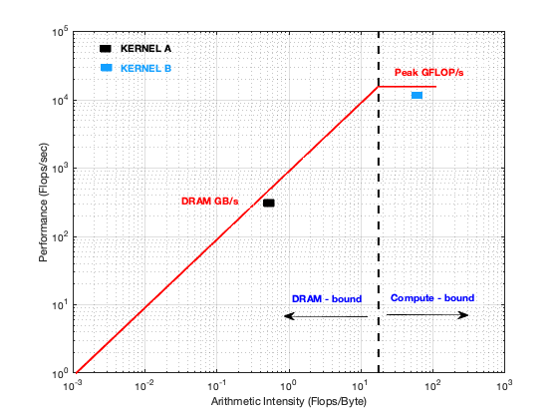
Section 2
Introduction to Roofline Analysis
Methodology
An Example Case: ASGarD
Application to ASKAP

Slide 12
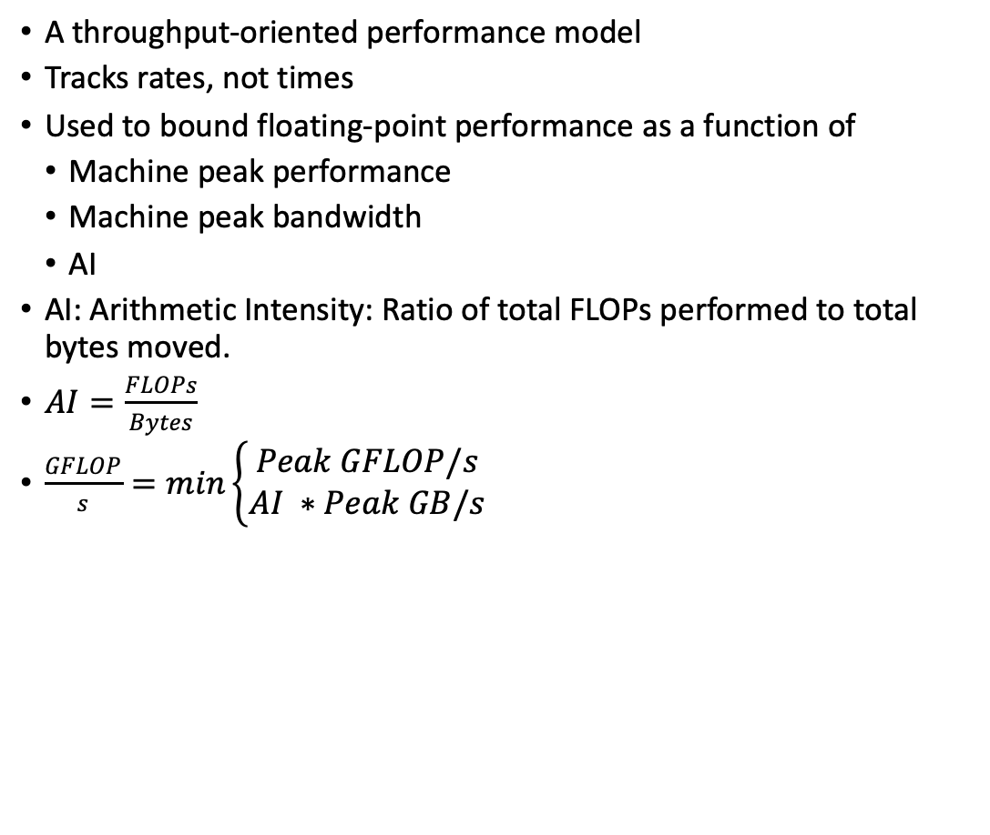
Roofline Analysis: Methodology
A throughput-oriented performance model
Tracks rates, not times
Used to bound floating-point performance as a function of
Machine peak performance
Machine peak bandwidth
AI
AI: Arithmetic Intensity: Ratio of total FLOPs performed to total bytes moved.
$AI=\frac{FLOPs}{Bytes}$
$\frac{GFLOP}{s}=min\left\{\begin{matrix}Peak GFLOP/s \\ AI ∗Peak GB/s\end{matrix}\right.$

Slide 13
Roofline Analysis: Methodology
A throughput-oriented performance model
Tracks rates, not times
Used to bound floating-point performance as a function of
Machine peak performance
Machine peak bandwidth
AI
AI: Arithmetic Intensity: Ratio of total FLOPs performed to total bytes moved.
$AI=\frac{FLOPs}{Bytes}$
$\frac{GFLOP}{s}=min\left\{\begin{matrix}Peak GFLOP/s \\ AI ∗Peak GB/s\end{matrix}\right.$
Machine Balance: Ratio of the peak performance to peak bandwidth

Slide 14
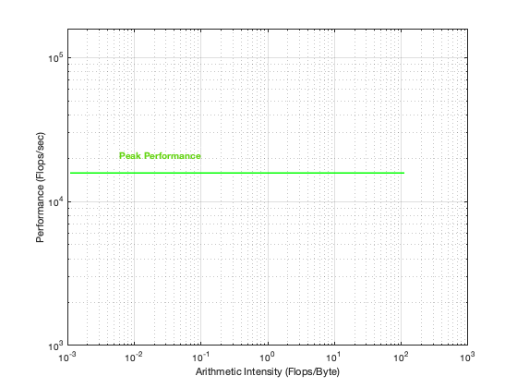
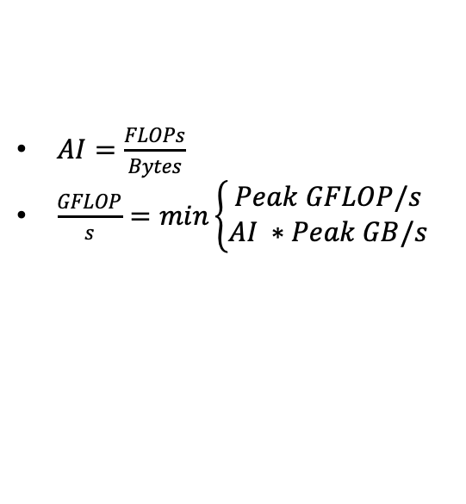
Roofline Analysis: Methodology
$AI=\frac{FLOPs}{Bytes}$
$\frac{GFLOP}{s}=min\left\{\begin{matrix}Peak GFLOP/s \\ AI ∗Peak GB/s\end{matrix}\right.$
Machine Balance: Ratio of the peak performance to peak bandwidth
x-axis: AI
y-axis: Performance (FLOP/sec)
In log-log scale
Plot the peak performance

Slide 15
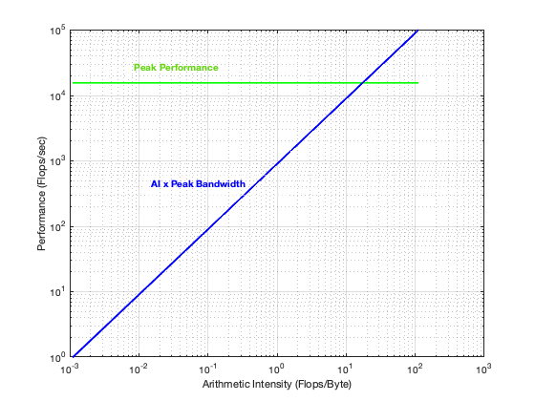
Roofline Analysis: Methodology
$AI=\frac{FLOPs}{Bytes}$
$\frac{GFLOP}{s}=min\left\{\begin{matrix}Peak GFLOP/s \\ AI ∗Peak GB/s\end{matrix}\right.$
Machine Balance: Ratio of the peak performance to peak bandwidth
x-axis: AI
y-axis: Performance (FLOP/sec)
In log-log scale
Plot the peak performance
Plot AI * peak bandwidth

Slide 16
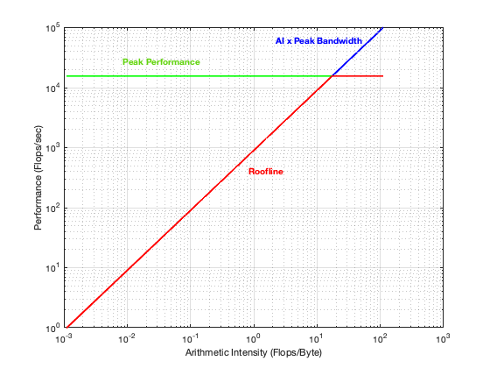
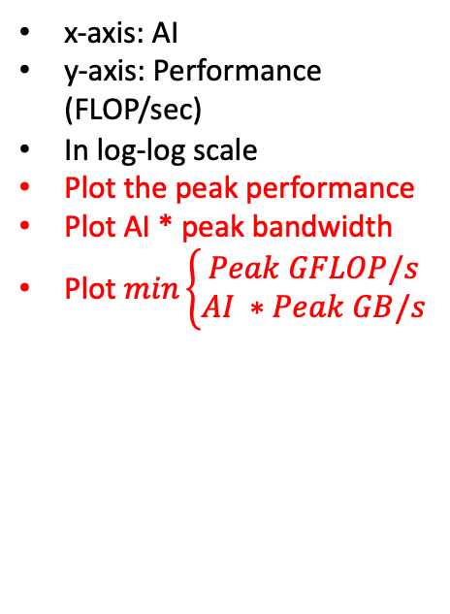
Roofline Analysis: Methodology
$AI=\frac{FLOPs}{Bytes}$
$\frac{GFLOP}{s}=min\left\{\begin{matrix}Peak GFLOP/s \\ AI ∗Peak GB/s\end{matrix}\right.$
Machine Balance: Ratio of the peak performance to peak bandwidth
x-axis: AI
y-axis: Performance (FLOP/sec)
In log-log scale
Plot the peak performance
Plot AI * peak bandwidth
Plot $min\left\{\begin{matrix}Peak GFLOP/s \\ AI ∗Peak GB/s\end{matrix}\right.$

Slide 17
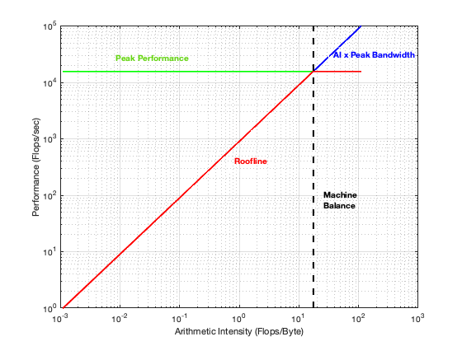
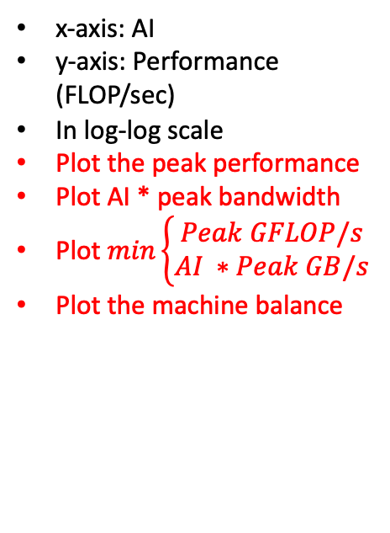
Roofline Analysis: Methodology
$AI=\frac{FLOPs}{Bytes}$
$\frac{GFLOP}{s}=min\left\{\begin{matrix}Peak GFLOP/s \\ AI ∗Peak GB/s\end{matrix}\right.$
Machine Balance: Ratio of the peak performance to peak bandwidth
x-axis: AI
y-axis: Performance (FLOP/sec)
In log-log scale
Plot the peak performance
Plot AI * peak bandwidth
Plot $min\left\{\begin{matrix}Peak GFLOP/s \\ AI ∗Peak GB/s\end{matrix}\right.$
Plot the machine balance

Slide 18
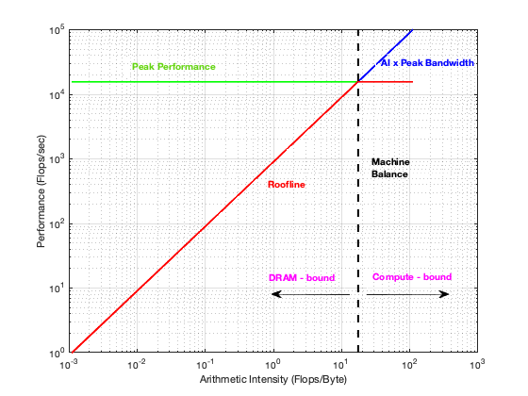
Roofline Analysis: Methodology
$AI=\frac{FLOPs}{Bytes}$
$\frac{GFLOP}{s}=min\left\{\begin{matrix}Peak GFLOP/s \\ AI ∗Peak GB/s\end{matrix}\right.$
Machine Balance: Ratio of the peak performance to peak bandwidth
RESULT:
Kernels with AI less than MB are ultimately bandwidth-bound
Kernels with AI greater than MB are ultimately compute-bound

Slide 19

Roofline Analysis: Methodology
Example:
Imagine you run on a future GPU with twice the peak FLOPs:
Kernel B’s performance could double
Imagine you run on a future GPU with twice the memory bandwidth:
Kernel A’s performance could double

Slide 20
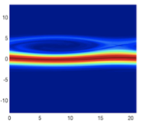
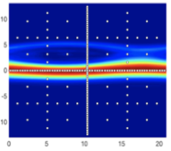
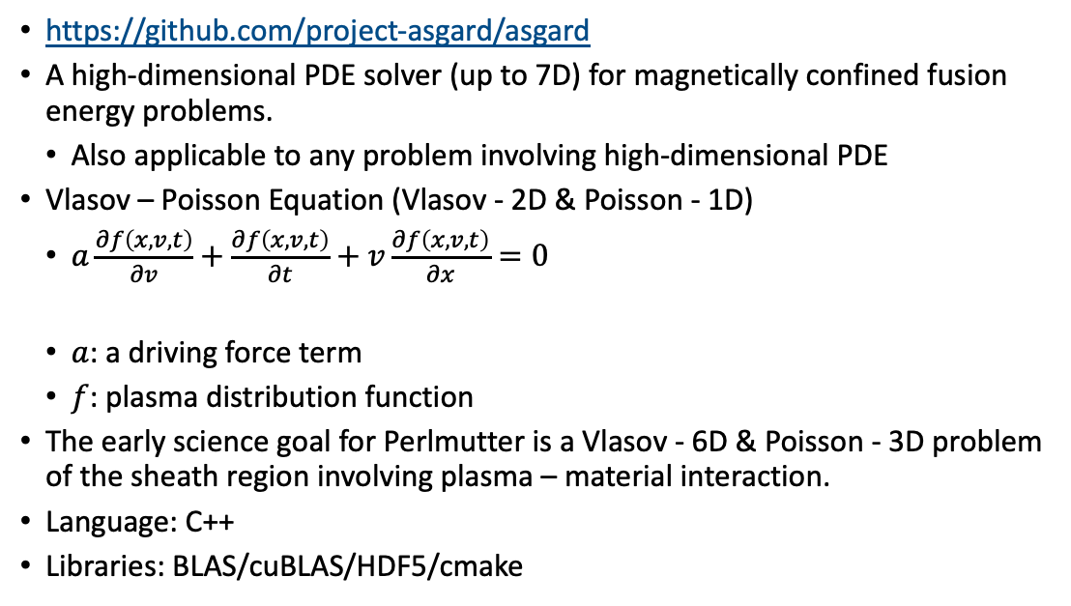
Roofline Analysis: An Example Case: ASGarD
https://github.com/project-asgard/asgard
A high-dimensional PDE solver (up to 7D) for magnetically confined fusion energy problems.
Also applicable to any problem involving high-dimensional PDE
Vlasov – Poisson Equation (Vlasov - 2D & Poisson - 1D)
$a\frac{∂f\left(x, v,t\right)}{∂v}+\frac{∂f\left(x, v,t\right)}{∂t}+v\frac{∂f\left(x, v,t\right)}{∂x}=0$
$a$: a driving force term
$f$: plasma distribution function
The early science goal for Perlmutter is a Vlasov - 6D & Poisson - 3D problem of the sheath region involving plasma – material interaction.
Language: C++
Libraries: BLAS/cuBLAS/HDF5/cmake

Slide 21
Roofline Analysis: An Example Case: ASGarD
Attended a GPU Hackathon
Team Members
ORNL – David Green, Tyler McDaniel, Ed D’Azevedo, Harry Hughes
NERSC – Ozgur Cekmer, Brian Friesen
Mentors
NVIDIA – Max Katz
HPE – Pierre Carrier
NERSC – Hugo Brunie

Slide 22
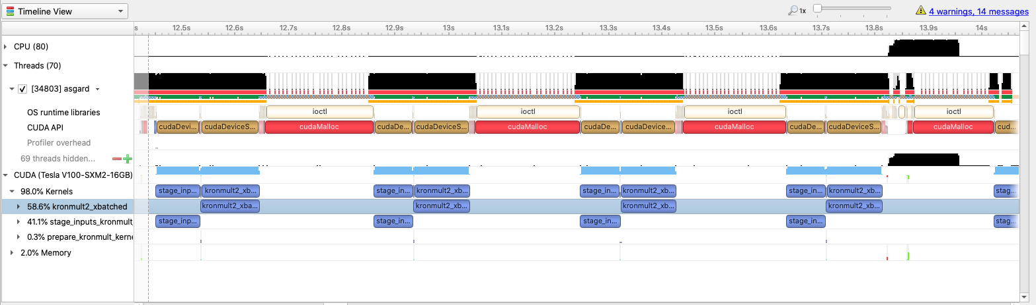
Roofline Analysis: An Example Case: ASGarD
Entire code timeline – Nsight systems

Slide 23
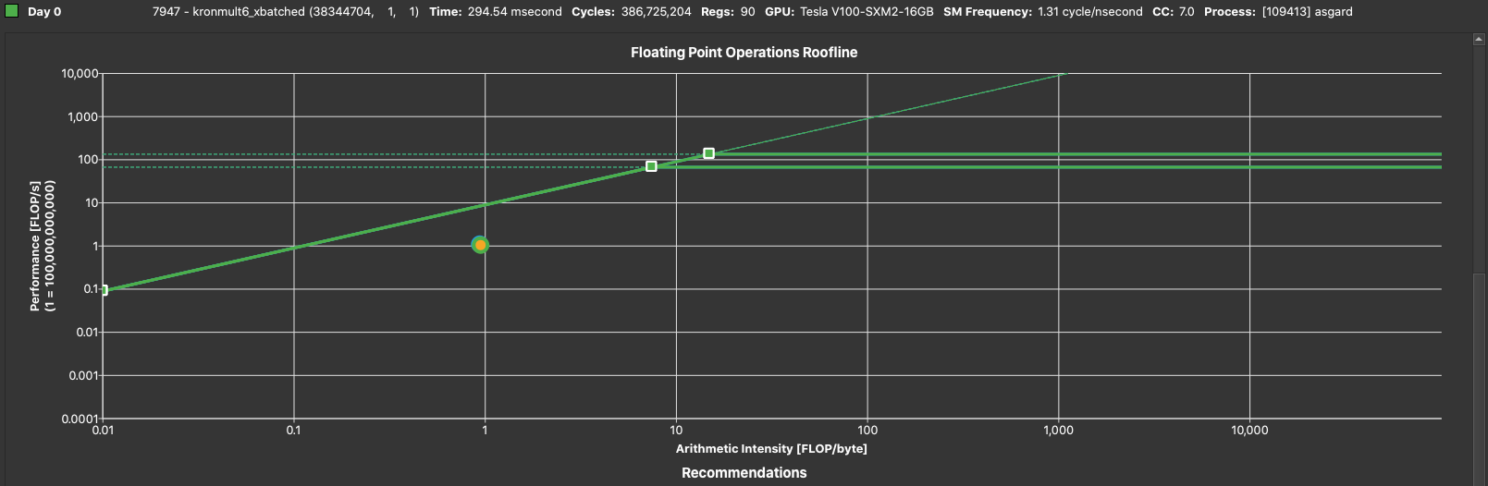
Roofline Analysis: An Example Case: ASGarD
Hackathon - Day 0

Slide 24
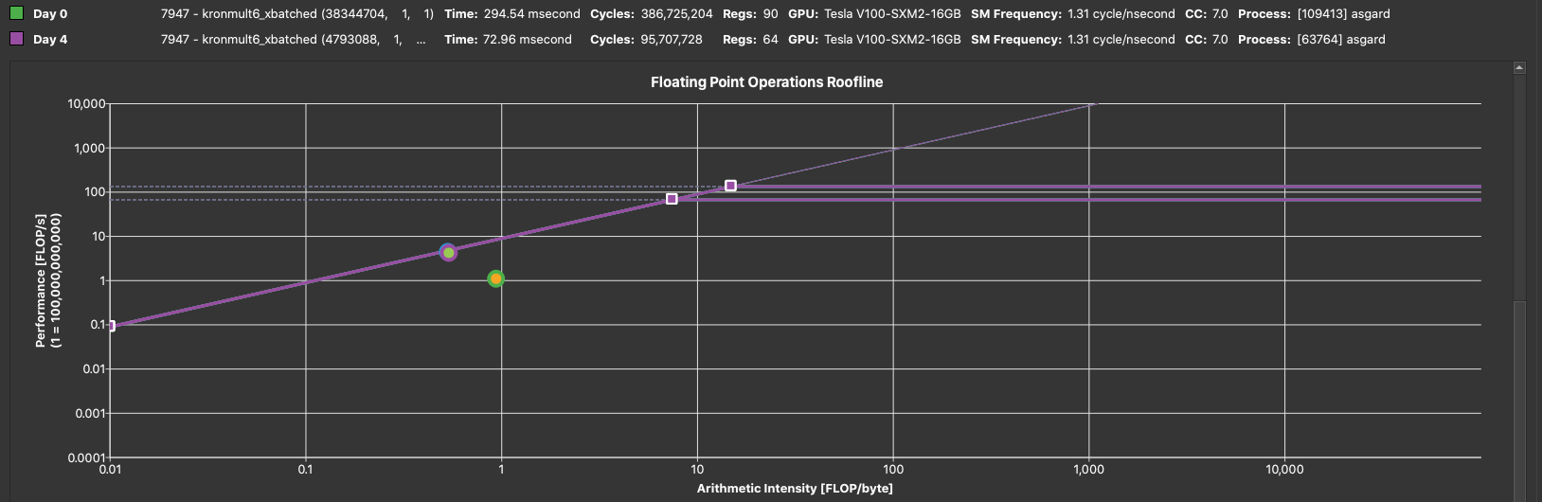
Roofline Analysis: An Example Case: ASGarD
Hackathon - Day 4
Main kernel for benchmark 6d problem: 4x speedup (295ms → 73ms)
Stage inputs kernel: 300ms → 10ms by fixing launch parameters

Slide 25
Roofline Analysis: An Example Case: ASGarD
Problem | Kernels | V100 | A100 | Speedup
C6, L4, D4 | stage_inputs_kronmult_kernel (in ms) | 12.02 | 4.02 | 2.99
 | prepare_kronmult ( in us) | 142.34 | 62.08 | 2.29
 | kronmult6_xbatched ( in ms) | 83.72 | 52.71 | 1.59

Slide 26
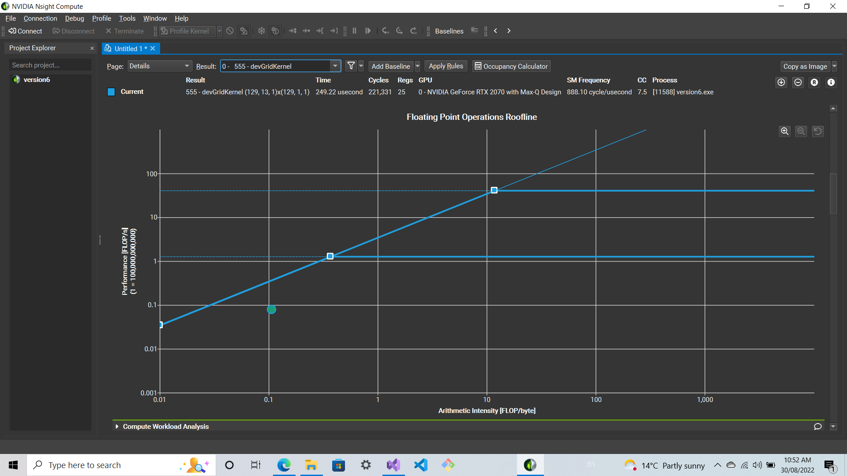
Roofline Analysis: YandaSoft preliminary results
Gridding

Slide 27
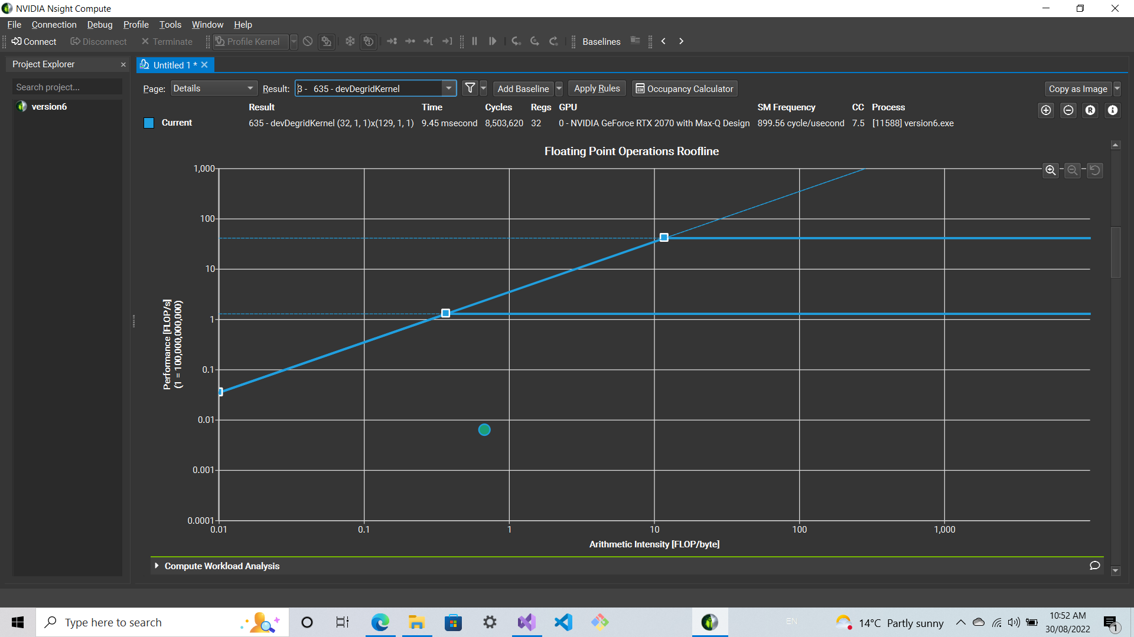
Roofline Analysis: YandaSoft preliminary results
Degridding

Slide 28
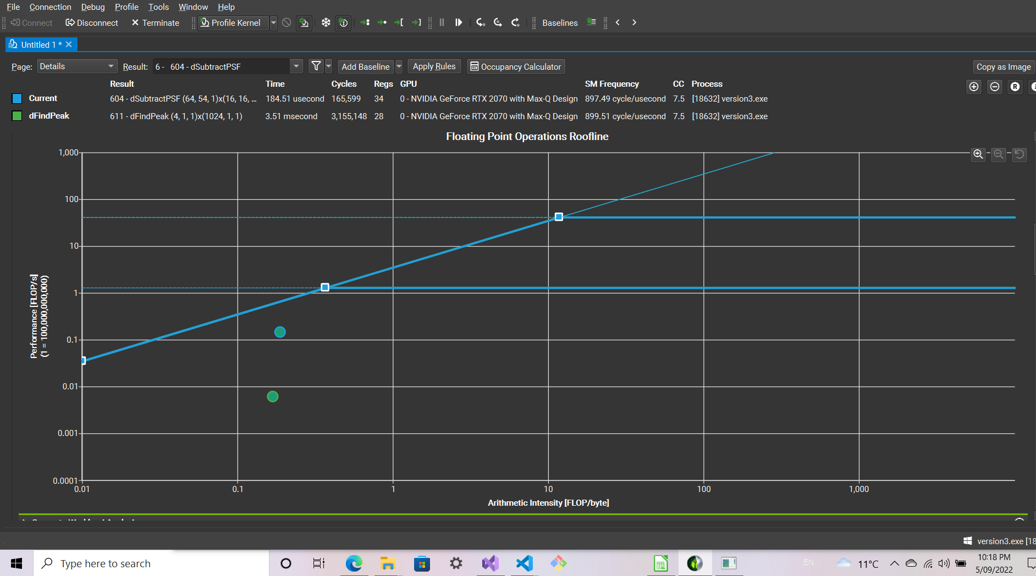
Roofline Analysis: YandaSoft preliminary results
Deconvolution

Slide 29
The next meeting…
To do list & Questions
Solve the problems with degridding kernel
Convert these CUDA codes into HIP
Benchmarking code repo, build, test, develop protocols.
Convert the methods with OpenMP offload into HIP – OpenMP offload???
Is it possible to get the related metrics to construct rooflines with HIP?
How similar are the performance results of HIP & CUDA (for the same kernel)
The best way to convert CUDA into HIP?
Is there any HIP function that gives you the maximum value and an index?

